Slide 1


Ads Recommendation
in a Collapsed and Entangled World
Industry
Track
Junwei Pan, Wei Xue, Ximei Wang, Haibin Yu,
Xun Liu, Shijie Quan, Xueming Qiu,
Dapeng Liu, Lei Xiao, Jie Jiang
Notes:
Hi everyone, I’m Junwei from Tencent.
I’m going to present our paper: Ads Recommendaiton in a Collapsed and Entangled World.

Slide 2
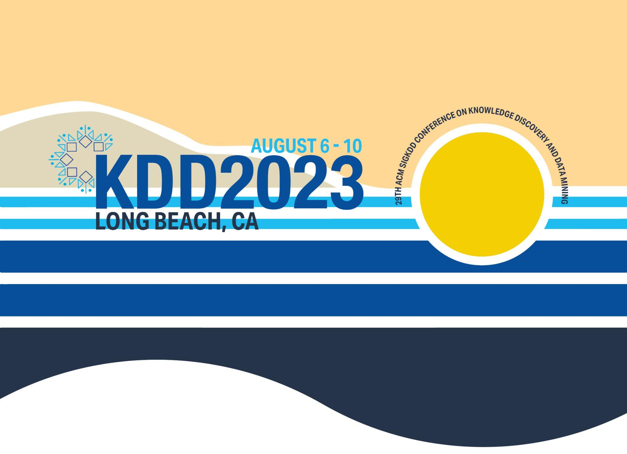
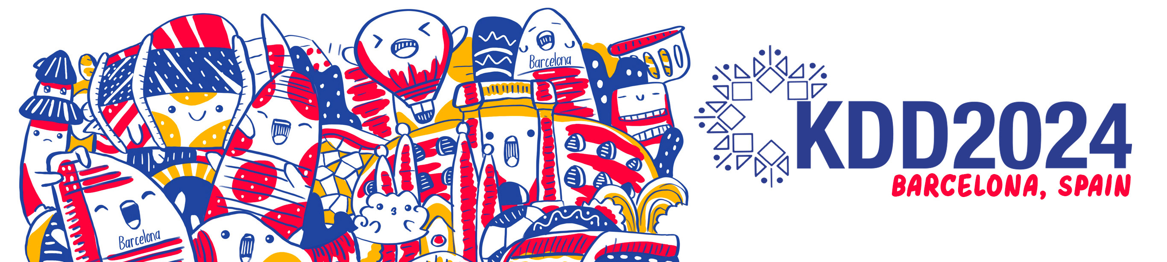
Overview
Three main challenges:
C1: Priors for Representation
C2: Dimensional Collapse
C3: Interest Entanglement
Others
Model Training Techniques
Analysis Tools
This work is a summary of many advances of Tencent Ads Science team in the last several years, some of them are published as individual papers (e.g., in ICML 2024, KDD 2024, WWW 2024, AAAI 2024, etc.).
Notes:
Here is an overview of the presentation.
We’ll talk about three main challenges in recommendation: how to preserve the priors when encoding features, how to handle the dimensional collapse of embeddings and user interest entanglement.
We’ll also discuss several practical model training techniques and analysis tools.
Please not this work is a summary of many advances of our team in the last several years, some of them are published as individual papers in ICML, KDD, WWW and AAAI.

Slide 3
Architecture
Our model follows the widely adopted Embedding & Explicit Interaction framework, which consists of four key modules:
Classification towers
Experts
Multi-embedding lookup
Feature encoding
Notes:
Here we show an overview architecture of our production model.
It consists of four components:
Feature encoding to preserve the priors of different types of features
Multi-embedding lookup to scale up models
Experts for explicit or implicit feature interaction
Classification tower to make the final prediction

Slide 4
Outline
Three main challenges:
C1: Priors for Representation
C2: Dimensional Collapse
C3: Interest Entanglement

Slide 5
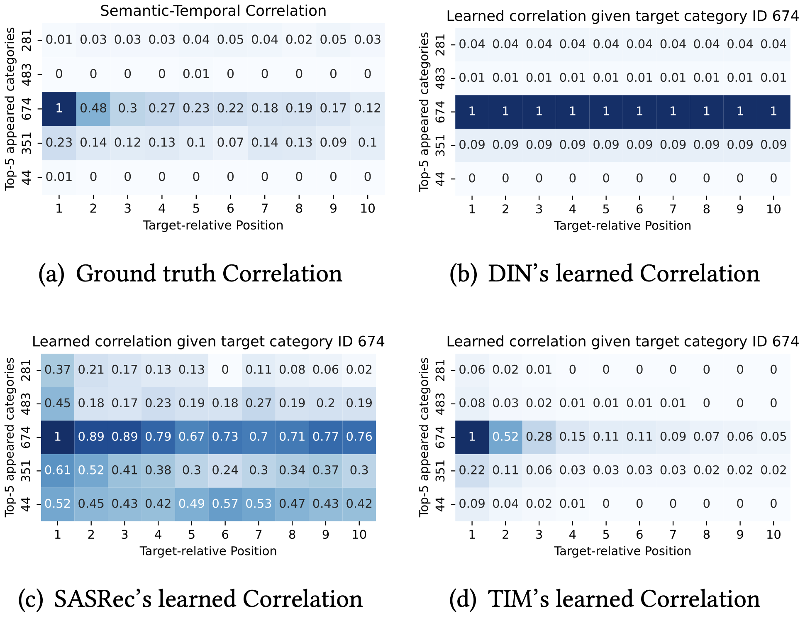
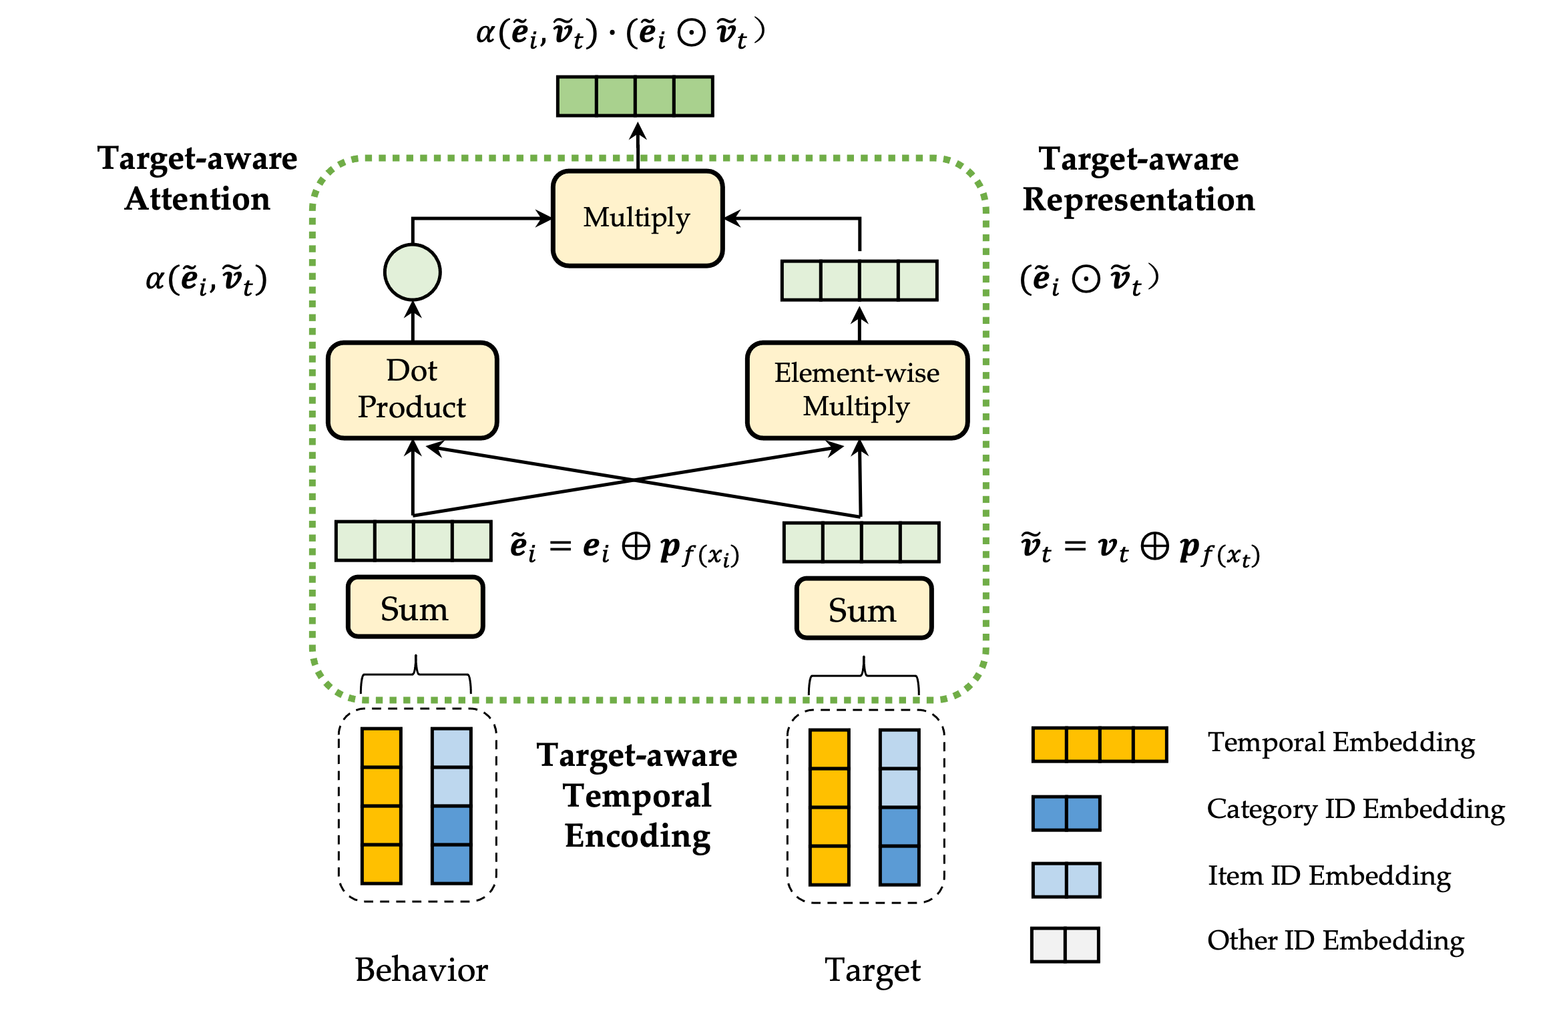
C1: Priors of Sequence Features
Target category: 674
Semantic correlation: behaviors with the same category as the target (674 here) are more correlated.
Temporal correlation: there is a strong temporal decaying pattern.
Our proposed TIN composes 3 key components: target-aware temporal encoding, target-aware attention and target-aware representation.
There are strong semantic and temporal correlation between behaviors and the target.
Existing SOTA methods fail to capture such correlation.
Temporal Interest Network for User Response Prediction. WWW 2024.
Notes:
First of all, we present how do we handle sequence features.
In recommendation systems, one critical sequential correlation is the semantic and temporal correlation between behaviors and the target.
That is, given that the target category, behaviors with the same category as the target are more correlated than other behaviors.
In addition, there is a strong temporal decaying pattern on these behaviors.
However, we analyze several SOTA methods and found them non of them can capture such pattern well.
To this end, we propose a novel Temporal Interest Module, which consists of three key components: target-aware temporal encoding to capture the temporal correlation, target-aware attention and target-aware representation to capture the 4-order semantic-temporal correlation.
Through visualization we can see that TIM captures the semantic-temporal correlation decently.

Slide 6
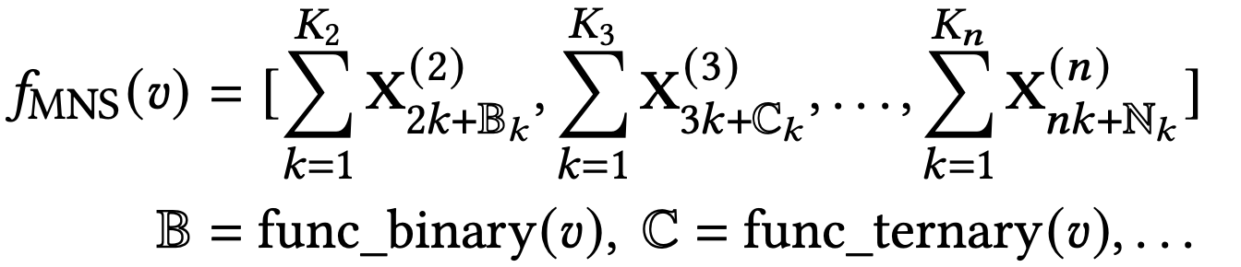
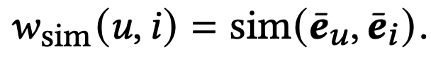
C1: Priors of Numeric & Embedding Features
Numeric Features
Embedding Features
Multiple Numeral Systems Encoding (MNSE):
Compute a similarity score based on the embeddings
Treat the score as a numeric feature, use the MNSE method
Notes:
For the numeric features, there are inherent partial orders between them, such as age 20 is younger than age 30.
To preserve such order priors, we use multiple numeral systems to encode them.
All the code embeddings are learned in the recommendation system end to end.
For the embedding features from GNN or LLM, we first compute a similarity score based on the user and item embeddings.
We then treat the score as a numeric feature, and use the above mentioned multiple numeral systems to encode them.

Slide 7
Outline
Three main challenges:
C1: Priors for Representation
C2: Dimensional Collapse
C3: Interest Entanglement

Slide 8
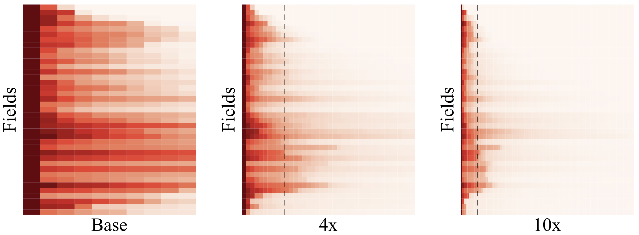
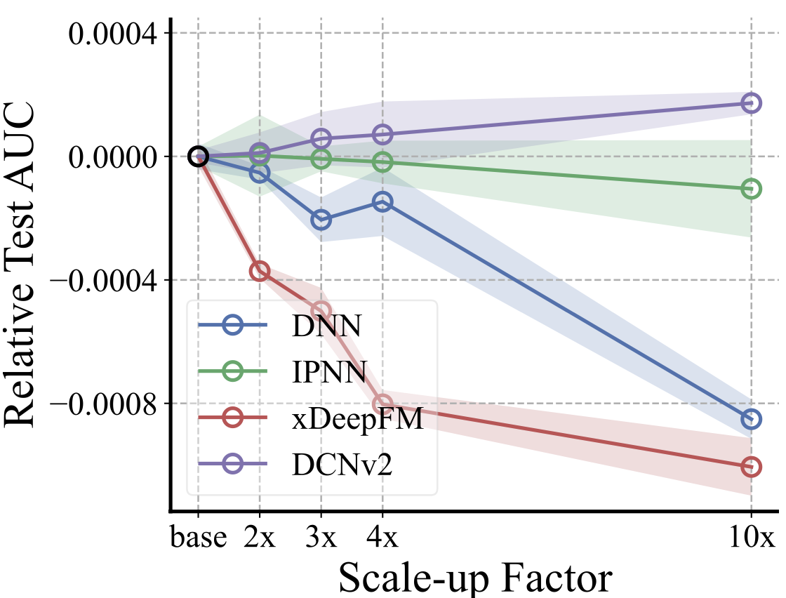
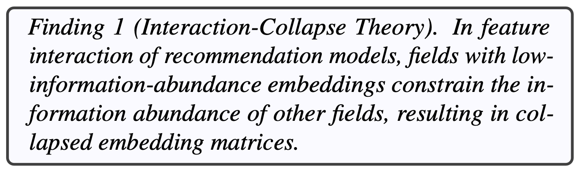
C2: Dimensional Collapse of Embeddings
Large Recommendation System
How to scale up recommendation models w.r.t. #parameters?
Most parameters in RecSys are embeddings (99.999%)
Simply enlarge the embedding dimension does not always work.
Singular spectrum analysis show dimensional collapse of embeddings
Many singular values are very small, indicating that embeddings of many fields end up spanning a lower-dimensional subspace instead of the entire available embedding space.
On the Embedding Collapse when Scaling up Recommendation Models. ICML 2024. Tencent Ads.
Notes:
Here we discuss how to scale up recommendation models, especially regarding the number of parameters.
Unlike NLP or CV, most parameters in RecSys are embeddings (99.999%).
One intuitive way to enlarge the model is to simply enlarge the dimension of all embeddings.
However, we found it does not work well. The performance is saturated or even become worse when we enlarge embedding dimensions.
We conduct singular spectrum analysis of the embeddings, and find that they are dimensionally collapsed.
That is, Many singular values are very small, indicating that embeddings of many fields end up spanning a lower-dimensional subspace instead of the entire available embedding space.
We propose an Interaction-Collapse Theory to explain this phenomenon. For details, please refer to our ICML paper.

Slide 9
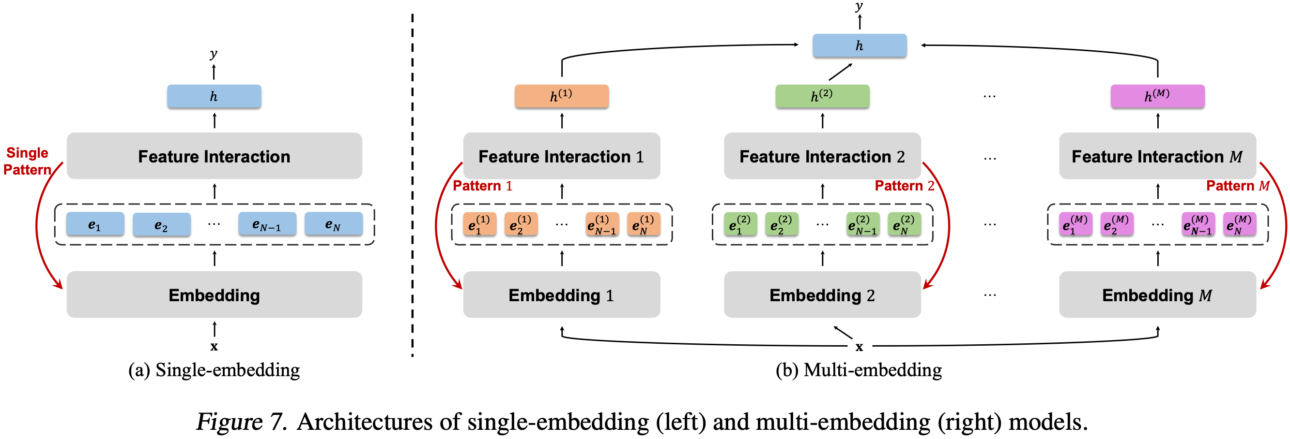
C2: Dimensional Collapse - Architecture
Instead of scaling up the model by enlarging the embedding dimensions, we scale by introducing more embedding tables: the Multi-Embedding paradigm.
Less influenced by the interaction-collapse theory and mitigate embedding collapse while keeping the original interaction modules
On the Embedding Collapse when Scaling up Recommendation Models. ICML 2024. Tencent Ads.
Notes:
To handle the dimensional collapse issue, we propose a novel approach: instead of scaling up the model by enlarging the embedding dimensions, we scale by introducing more embedding tables.
We name it as the Multi-Embedding paradigm.
We find this new paradigm is less influenced by the interaction-collapse theory, and therefore mitigates the dimensional collapse of embeddings.

Slide 10
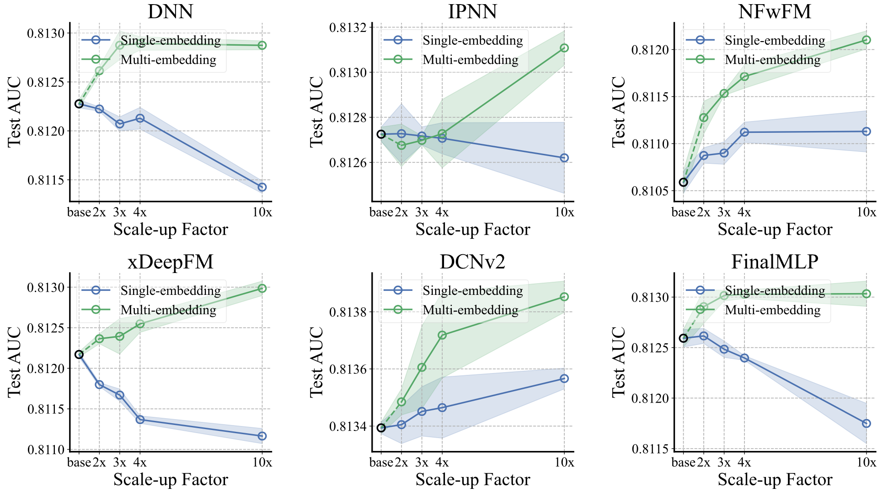
C2: Dimensional Collapse - Results
Can be applied to all existing CTR models
Compared to Single-Embedding, Multi-Embedding paradigm, successfully achieves scale-up regarding #params
On the Embedding Collapse when Scaling up Recommendation Models. ICML 2024. Tencent Ads.
Notes:
Our paradigm can be applied to all existing CTR models, including DNN, IPNN, NFM, xDeepFM, DCN V2 and FinalMLP.
Comprehensive experiment results show that our paradigm successfully achieves model scale up on all these 6 approaches, that is, the more parameters, the better performance.

Slide 11
Outline
Three main challenges:
C1: Priors for Representation
C2: Dimensional Collapse
C3: Interest Entanglement

Slide 12
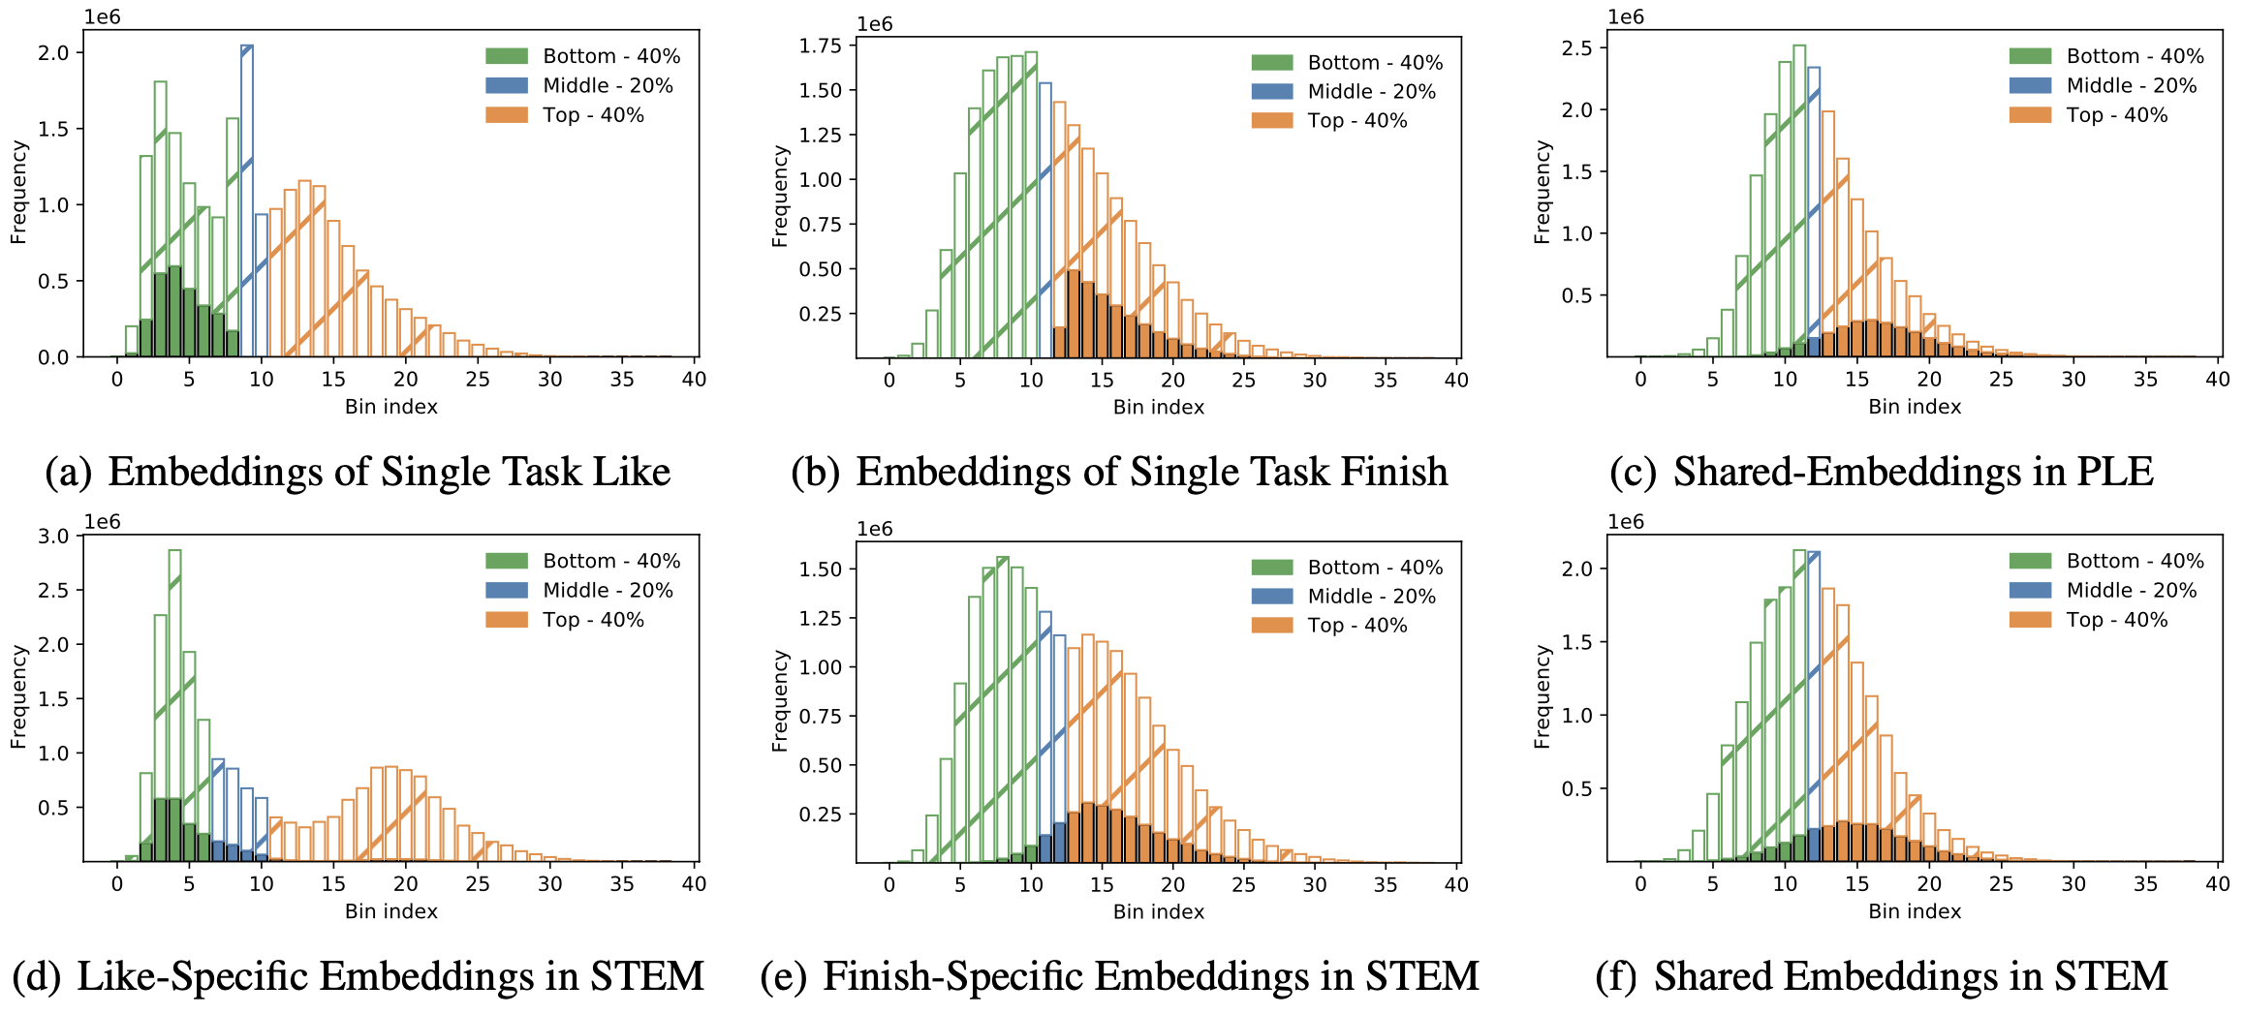
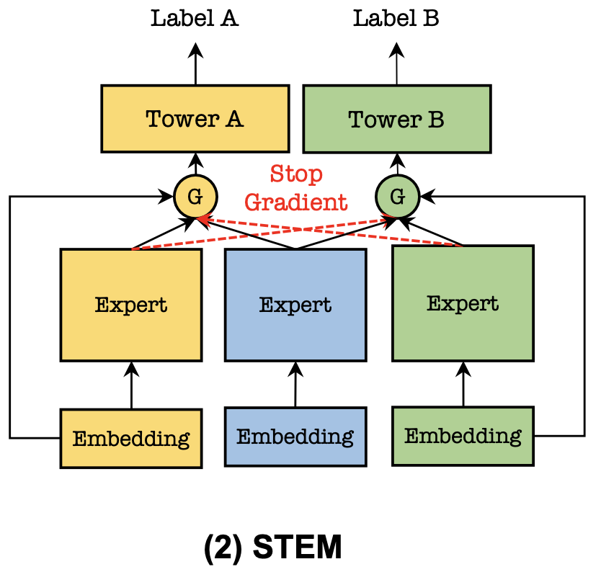
C3: Interest Entanglement
Consider two tasks: like and finish.
We select a set of (user, item) pairs with conflicting embedding distance (interest) according two individual tasks’ embeddings.
Shared-and Task-specific Embedding paradigm.
STEM: Unleashing the Power of Embedding for Multi-Task Recommendation. AAAI 2024.
Notes:
Modern recommendation systems tend to model multiple tasks or scenarios in one model.
However, there may be conflicting user interests across these tasks.
Here we show an example.
We consider two tasks Like and Finish, and we select a set of (user, item) pairs with conflicting embedding distance (interest) according two individual tasks’ embeddings.
That is, we select a set of (user, item) pairs whose embedding distance is low in task Like, and high in task finish.
We then check their distance in shared-embedding MTL methods such as PLE.
Surprisingly, we found it’s still dominated by one task, Finish here.
To disentangle such interest entanglement, we propose STEM, to learn task-specific embedding tables.
That is, each task has its own independent embedding tables, optimized only by the gradient from its samples.
We can see each task’s embedding table successfully captures its distinct interest.

Slide 13
C3: Interest Entanglement, Architecture
For Single-Task Learning
Tackle dimensional collapse
For Multi-Task Learning
Tackle interest entanglement
For Auxiliary Learning
Tackle interest entanglement
Multi-Task or Multi-Domain Learning
STEM: One embedding table for each task: too many embedding tables!
AME (Asymmetric Multiple-Embedding): Fixed number of embeddings, with different dimension to disentangle them.
Crocodile: Fixed number of embeddings, with an explicit disentangle loss.
Auxiliary Learning
STEM-AL: One embedding for the main task, and one shared embedding for all tasks.
STEM: Unleashing the Power of Embedding for Multi-Task Recommendation. AAAI 2024.
Crocodile: Cross Experts Covariance for Disentangled Learning in Multi-Domain Recommendation. arxiv 2024.
Notes:
In practice, when there are many tasks, learning one independent embedding table for each task is unacceptable.
Instead, we propose a novel Asymmetric Multiple-Embedding paradigm, that is, we only learned a fixed number of embedding table, each with a different embedding dimension to disentangle them.
Another possible disentanglement approach is to introduce a disentangle loss upon these embedding tables.
Besides, we also apply STEM for auxiliary learning, that is, to enhance the performance of a target task with the knowledge from other tasks.
Due to time limit, we’ll skip it here.
Please note there are difference between the above mentioned paradigms so far.
The Multi-Embedding paradigm is mainly for single-task learning, and it aims to tackle the dimensional collapse challenge.
While STEM and AME is for multi-task learning, tackling the interest entanglement challenge.

Slide 14
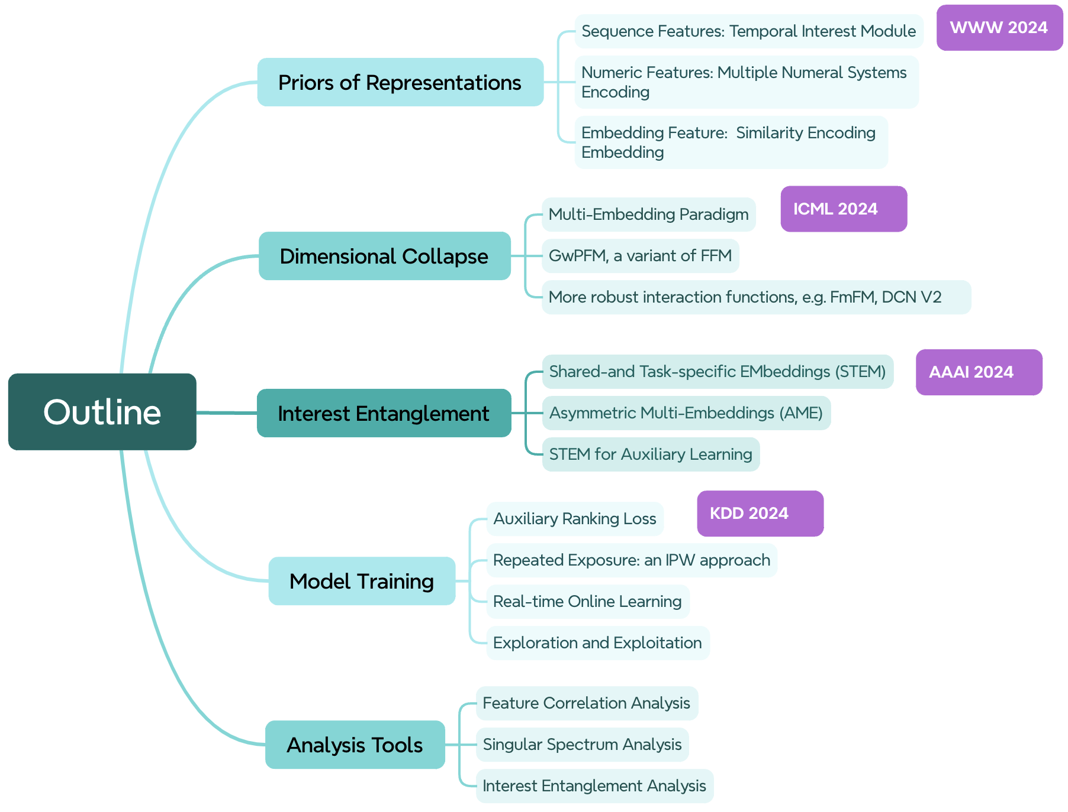
Overview

Slide 15


Q & A
Reference papers by our team:
Temporal Interest Network for User Response Prediction. WWW 2024.
On the Embedding Collapse when Scaling up Recommendation Models. ICML 2024.
STEM: Unleashing the Power of Embeddings for Multi-task Recommendation. AAAI 2024.
Understanding the Ranking Loss for Recommendation with Sparse User Feedback. KDD 2024.
Notes:
As I mentioned in the beginning, several methods in this work are already published as individual papers, and here is the information of these papers.
Right is the QR for our analysis code.
Any Questions?

Slide 16
Outline
Three main challenges:
C1: Priors for Representation
C2: Dimensional Collapse
C3: Interest Entanglement
Others
Model Training
Analysis Tools

Slide 17
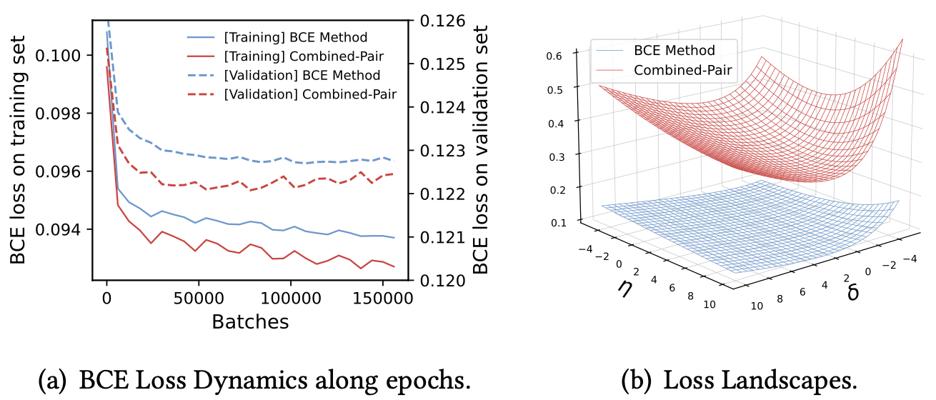
Model Training
$$L^{CP}=αL_{BCE}+\left(1−α\right)L_{RankNet}$$
Auxiliary Ranking Loss: Gradient Vanishing of Negative Samples.
Repeated Exposure: Inverse-Propensity Weighting
Real-time Online Learning: tackling the delayed feedback issue.
Gaussian Process for Exploitation and Exploration.
Understanding the Ranking Loss for Recommendation with Sparse User Feedback. KDD 2024.
Notes:
We also introduce several model training techniques to handle various challenges.
For example, we use auxiliary ranking loss in addition to the binary Cross-Entropy loss to resolve the gradient vanishing of negative samples.
We use Inverse Propensity Weighting to reduce the repeated exposure of ads.
We employ real-time online learning for both click prediction and conversion prediction, and tackles the delayed feedback issue.
We use Gaussian Process for exploitation and exploration.

Slide 18
Outline
Three main challenges:
C1: Priors for Representation
C2: Dimensional Collapse
C3: Interest Entanglement
Others
Model Training
Analysis Tools
Notes:
Here is an overview of the presentation.
We’ll talk about three main challenges in recommendation: how to preserve the priors when encoding features, how to handle the dimensional collapse of embeddings and user interest entanglement.
We’ll also discuss several practical model training techniques and analysis tools.
Please not this work is a summary of many advances of our team in the last several years, some of them are published as individual papers in ICML, KDD, WWW and AAAI.

Slide 19
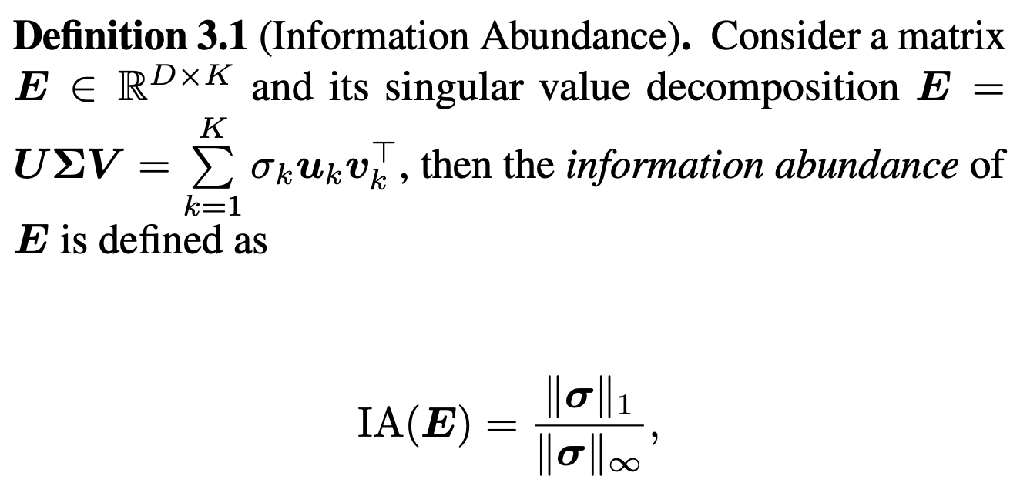
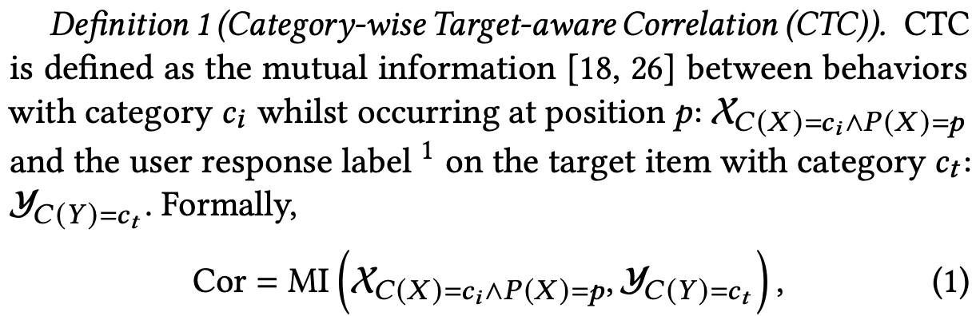
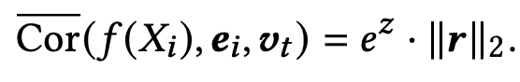
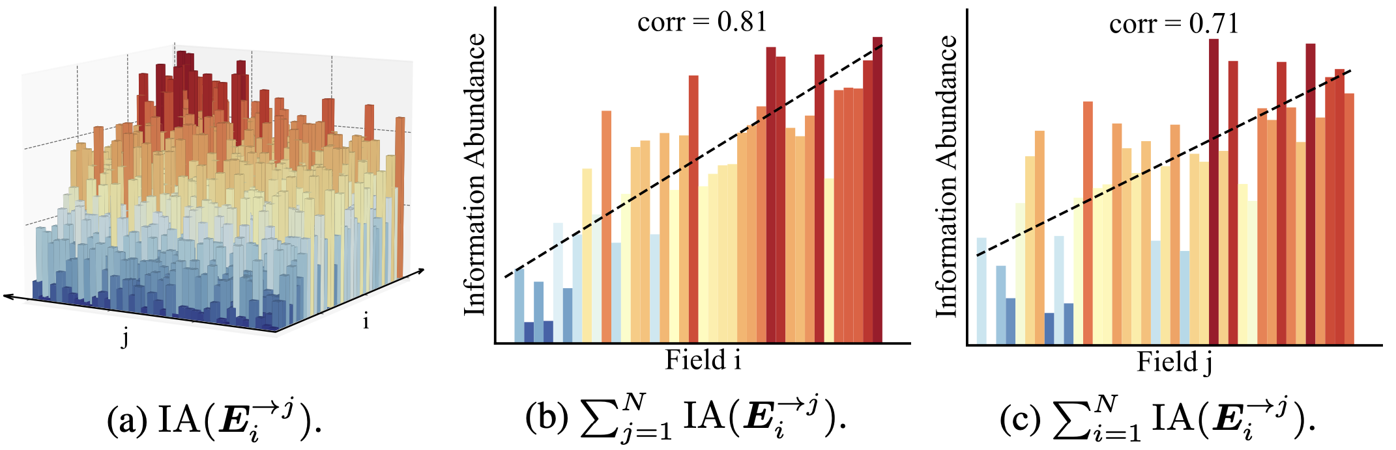
Analysis Tools
Feature Correlation
Dimensional Collapse
Interest Entanglement
Ground truth: mutual information.
Select a set of contradictory user item pairs whose embedding distance are among the top-40% regarding single task A embedding the bottom-40% regarding single B embedding .
Plot the distance distribution of these pairs regarding embeddings of MTL models.
Learned:
Notes:
Least but not last, we introduce several analysis tools here.
For feature correlation analysis, we use mutual information between features and label to measure the ground truth-correlation.
We the propose approaches to measure the learned correlation.
For dimensional analysis of embeddings, we propose information abundance based on singular value analysis to quantify the extent of collapse.
For user interest entanglement, we quantify it by embedding distance analysis.

